Slide 1


Sales Optimization Overview
Sales & Profitability Optimization
By Krish Patel

Slide 2
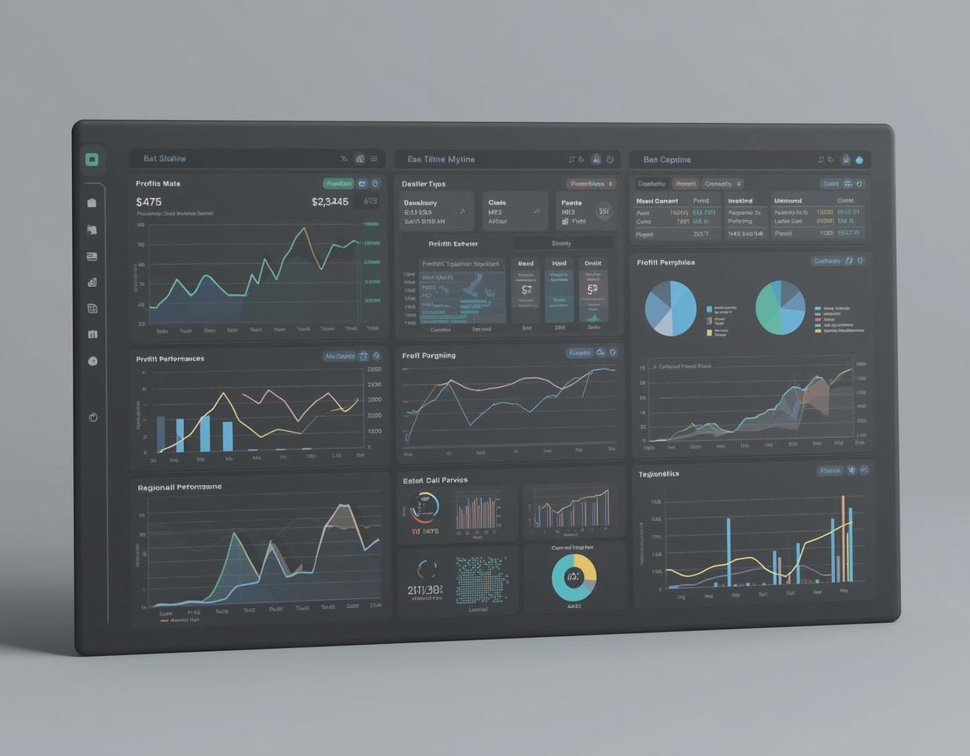
Key Business Challenges Overview
Revenue is strong but profit is inconsistent.
Certain regions and categories underperform.
Aggressive discounting may be reducing margins.
Business needs data-driven pricing optimization.
Understanding Revenue vs. Profit Issues
Revenue is strong; profit remains inconsistent.

Slide 3
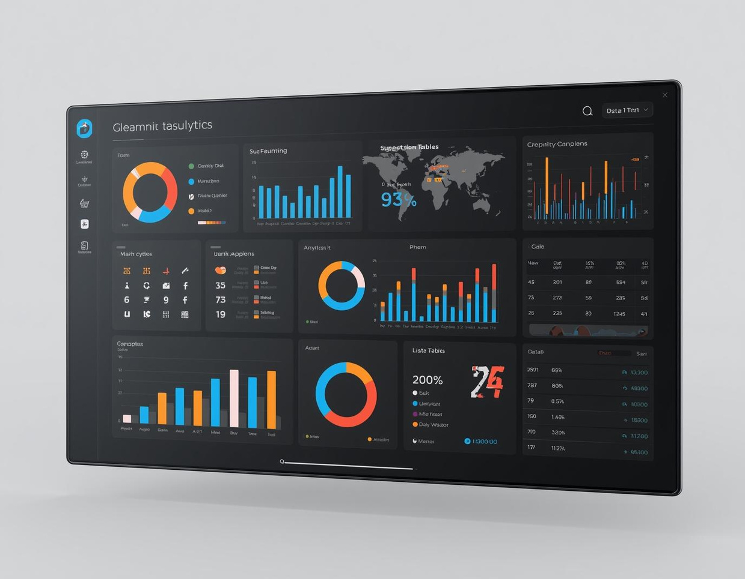
Dataset Overview: Sales Transactions Analysis
Key features: Sales, Profit, Discount, Category, Region, Customer Segment
Comprehensive Analysis of Sales Data
9,994 sales transactions provide valuable insights.

Slide 4
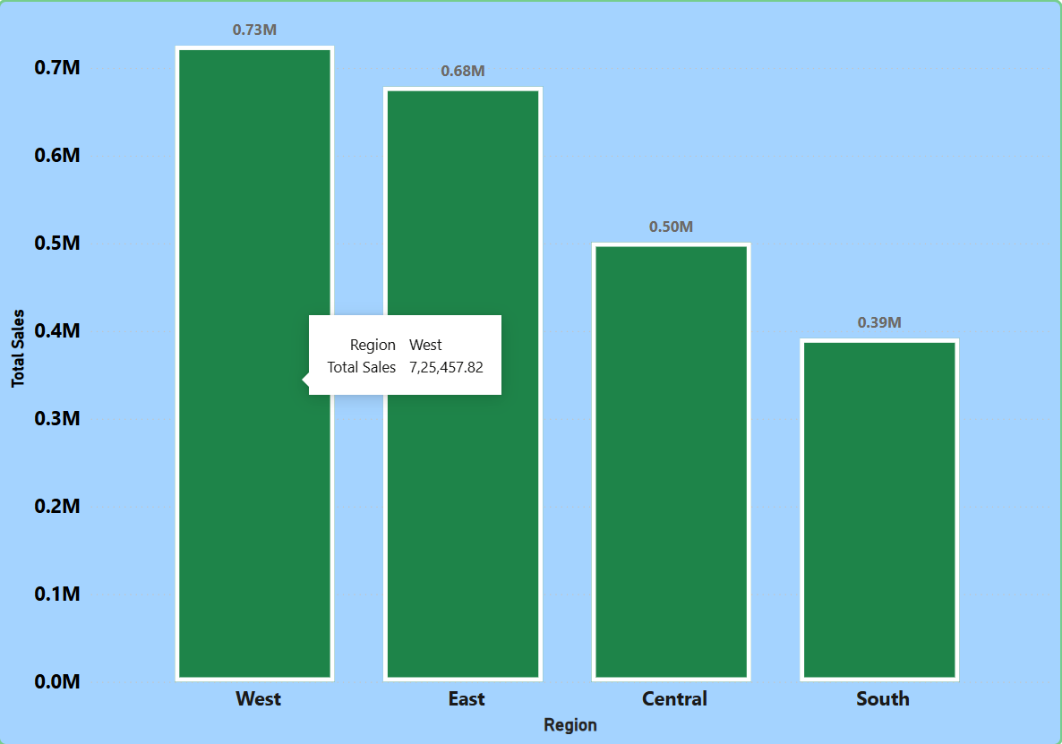
Regional Performance
The West region has shown remarkable profitability, outperforming others significantly, highlighting the need for strategic focus and resource allocation.

Slide 5
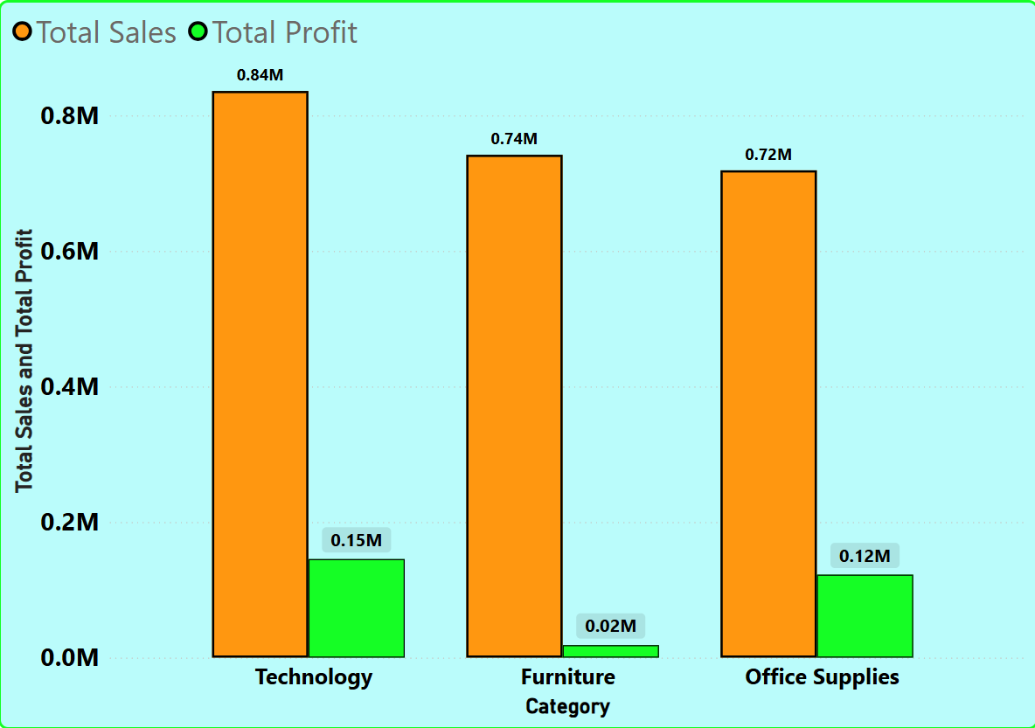
Category Performance
The Technology category consistently outperforms others, driving significant profit margins and necessitating focused strategy adjustments going forward.
Furniture generates lower margins.
Category-level strategy required.

Slide 6
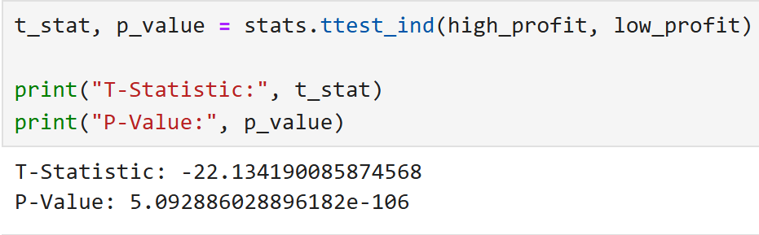
Discount Impact
Statistical Validation of Pricing Effects
High discounts have a significant negative impact on average profit, as supported by statistical analysis indicating strong evidence against discounting strategies that harm profit margins.

Slide 7
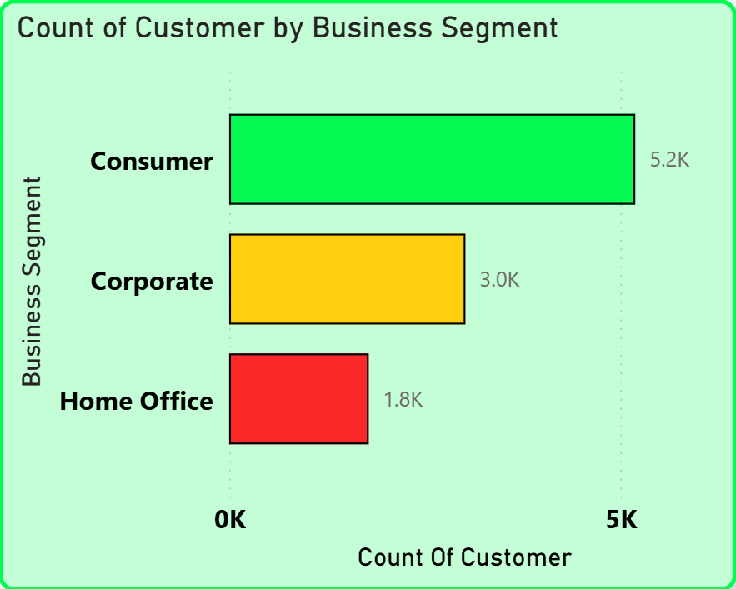
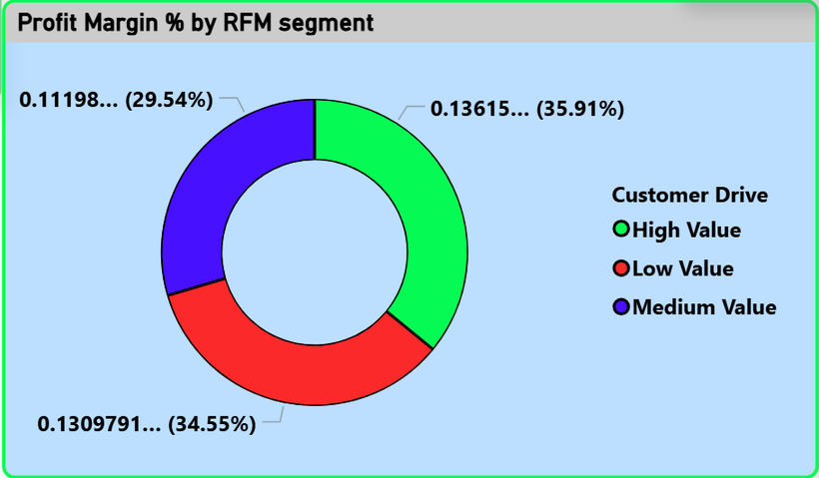
Customer Insights and Segmentation
Understanding Business Segment Customers
Understanding High-Value Customers
Some segments show lower engagement
High-value customers are essential for business growth.

Slide 8
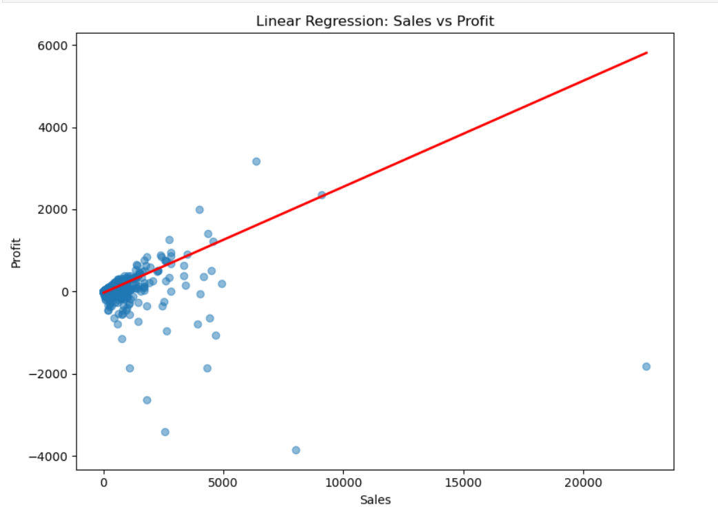

Predictive Modeling Insights for Profitability
Understanding Non-Linear Profit Influences
Evaluating complex factors affecting profit margins.
Profitability influenced by non-linear factors.

Slide 9


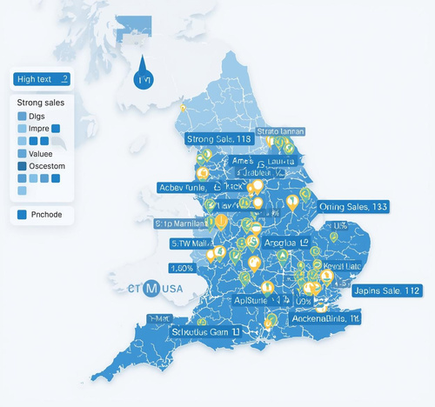
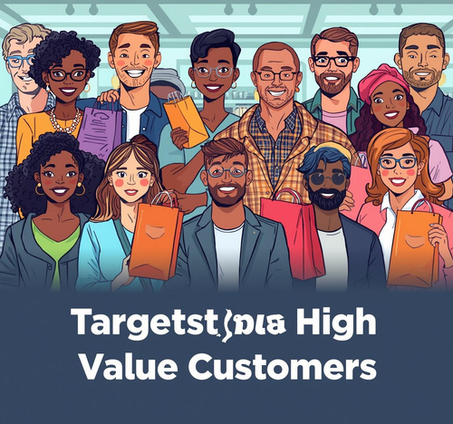

Optimize Discounts
High-Margin Focus
Strengthen Regions
Focus on effective pricing to enhance profits.
Prioritize categories with the best profitability margins.
Reinforce strategies in areas generating the most profit.
Target Customers
Monitor Segments
Engage and retain high-value customers effectively.
Keep track of underperforming business areas closely.

Slide 10

Call to Action
Drive sustainable profitability growth
Adopt a data-driven pricing and customer strategy to improve sustainable profitability

